Slide 1

Web Analytics

Slide 2
Key Metrics
There are three key metrics in web analytics
  (i) Behavior Analysis
  (ii) Outcomes Analysis
  (iii) Experience Analysis

Slide 3
Key Metrics
Behavior Analysis
Behavior Analysis is also called as click stream data analysis.
It is the process of collecting, analyzing and reporting aggregate data about which pages a website visitor visits and in what order.
Aim is to infer the intent of the visitor.

Slide 4
Behavior Analysis
Visits/Sessions
When someone visits your WebPages, it is called visits or session.
  Click versus visit
  Unique visitors
Methods to calculate Unique Visitors
  Cookie based method
  IP- based method

Slide 5
Behavior Analysis
Time on site
Time on site metric indicate engagement of the visitors.
The more time spend on the site, the greater is the stickiness of the site.
But, it cannot be generalized, in some website less time is good for user experience.

Slide 6
Behavior Analysis
Time on site
Tabbed Browsing
All of us open multiple tabs while browsing. How is time calculated in tabbed browsing?
  The First Method
  Linearization

Slide 7
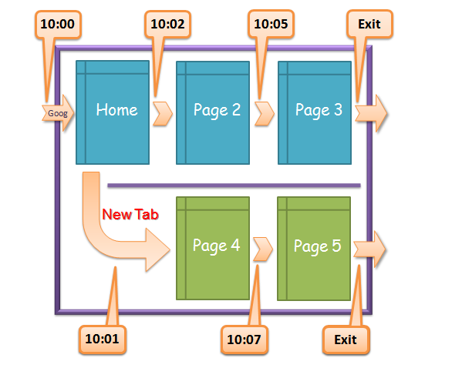
Behavior Analysis
Time on site

Slide 8
Behavior Analysis
Time on site
The web analytics tool takes the above picture literally and this happens…..
Outcomes: Two Sessions, one for each tab in the browser.
Session One (top): [referrer -> Google]
Tp (Home Page) = 2 minutes
Tp (Page 2) = 3 minutes
Tp (Page 3) = 0 minutes
Ts (session duration) = 5 minutes
Session Two (bottom): [referrer -> your site/homepage]
Tp (Page 4) = 6 minutes
Tp (Page 5) = 0 minutes
Ts (session duration) = 6 minutes
Net : 2 Visits. 1 Unique Visitor.
Also notice the impact on referrers (for the second one you'll see your site referring to itself).
Really interesting outcome!

Slide 9
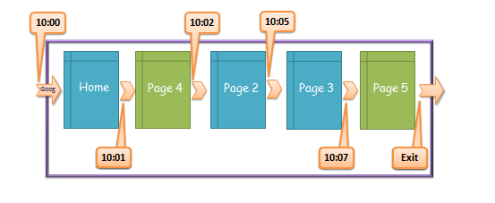
Behavior Analysis
Time on site

Slide 10
Behavior Analysis
Time on site
Outcomes: One Sessions, visit “reorganized” by time stamps.
Session One: [referrer -> Google]
Tp (Home Page) = 1 minute
Tp (Page 4) = 1 minute
Tp (Page 2) = 3 minutes
Tp (Page 3) = 2 minutes
Tp (Page 5) = 0 minutes
Ts (session duration) = 7 minutes
Net : 1 Visit. 1 Unique Visitor.
Neither one perfectly captures exactly what the Visitor is actually doing on your site.

Slide 11
Behavior Analysis
Bounce Rate
Bounce Rate is the percentage if single page visits.
The visits in which user leaves from the landing page without interacting with the page.
If the user interacts by playing a video or answering a poll or using a flicker or closing a pop-up, then it will not be counted as a bounce.

Slide 12
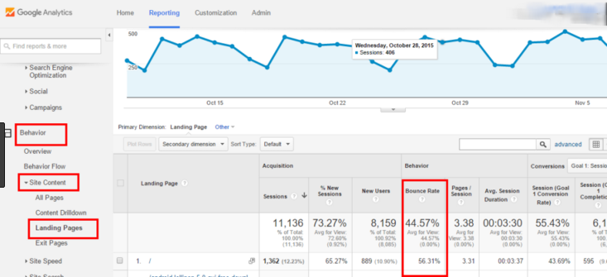
Behavior Analysis
Bounce Rate

Slide 13
Behavior Analysis
Exit Pages
It is important to know from which pages users are exiting the most.
Pages from where visitors are dropping off in the process of buying a product are called exit pages.

